Slide 1

CHEM SEC 203
SECTION B
ANALYSIS OF WATER
PART II

Slide 2
TOPICS TO BE COVERED IN THIS LECTURE
Determination of dissolved oxygen of a water sample
Determination of Ph ,acidity and alkalinity of a water sample

Slide 3
Dissolved oxygen(DO)
BOD and COD
The amount of oxygen dissolved in water is DO.It comes from direct absorption from air and release from photosynthetic activities of aquatic plants.
BOD is biological oxygen demand ,defined as the amount of dissolved oxygen required by the aerobic bacteria to oxidise the organic and inorganic matter ina given water sample at a certain temperature.
COD is chemical oxygen demand ,defined as measure of the oxygen equivalent of that portion of organic matter ina sample that is susceptible to oxidation by a strong oxidising agent.

Slide 4
Determination of dissolved oxygen in a water sample
Disolved oxygen in a water sample can be determined by two methods:
Oxygen meter method
Winkler’s method

Slide 5
Oxygen meter method
This is a convenient method which requires oxygen meter,an electric stirrer and 5% sodium sulphite solution
PROCEDURE :STEP1: Adjust and calibrate the instrument by dipping the probe into 5% sodium sulphite solution taken in a beaker while constantly stirring the solution.Set the oxygen meter mark at zero mark.
STEP2: Take watersample in abeaker and dip the oxygen meter into itwhile constantly stirring the water.
STEP 3:Note the reading on the scale which gives the dissolved oxygen in the sample of water in mg/lt

Slide 6
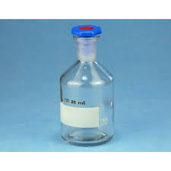
Winkler’s Method
PRINCIPLE
WINKLER BOTTLE
:In this method the water sample is reacted with concentrated solution of MnSO4,NaOH,KI and NaN3.First white ppt of Mn(OH)2 is formed which changes to Mn(OH)3 brown ppt.The dissolved oxygen in water sample is fixed and on acidification Mn3+ changes back to Mn2+and liberats equivalent amount of iodine from potassium iodide
This liberated iodine is determined by titration with hypo solution..The interference due to nitrites if present in water is removed by reaction with sodim oxide.

Slide 7
Winklers method
Reagents required:
Water sample
Manganese sulphate solution 50g in 100ml water
Alkaline potassium iodide solution.40gNaOH+20g KI +0.5g NaN3 in 100ml water
Sodium thiosulphate solution12.4g/lt
Potassium dichromate solution:2.45g/lt
Starch solution:1g/100ml warm water
Winkler bottle
A Winkler bottle is a piece of laboratory glassware specifically made for carrying out the Winkler test. These bottles have conical tops and a close fitting stopper to aid in the exclusion of air bubbles when the top is sealed. This is important because oxygen in trapped air would be included in the measurement and would affect the accuracy of the test.

Slide 8
Determination of dissolved oxygen of a water sample(Step 1)
In the first step, manganese(II) sulphate (at 48% of the total volume) is added to an environmental water sample. Next, potassium iodide (15% in potassium hydroxide 70%) is added to create a pinkish-brown precipitate. In the alkaline solution, dissolved oxygen will oxidize manganese(II) ions to the tetravalent state.
2 Mn²⁺_{(aq)}+ O_{2(aq)} + H₂O_{(l)} → 2 MnO(OH)_{2(s)}Mn has been oxidised to 4+, and MnO(OH)₂ appears as a brown precipitate.
There is some uncertainty about whether the oxidised manganese is tetravalent or trivalent. Some sources claim that Mn(OH)₃ is the brown precipitate, but hydrated MnO₂ may also give the brown colour.
4 Mn(OH)₂(s) + O₂(aq) + 2 H₂O → 4 Mn(OH)₃(s

Slide 9
Winklers method:Step 2
The second part of the Winkler test reduces (acidifies) the solution. The precipitate will dissolve back into solution as the H⁺ reacts with the O²⁻ and OH⁻ to form water.
MnO(OH)_{2(s)} +4H⁺_{(aq)} → Mn⁴⁺_{(aq)} + 3 H₂O_{(l)}The acid facilitates the conversion by the brown, Manganese-containing precipitate of the Iodide ion into elemental Iodine.
The Mn(SO₄)₂ formed by the acid converts the iodide ions into iodine, itself being reduced back to manganese(II) ions in an acidic medium.
Mn(SO₄)₂ + 2 I⁻(aq) → Mn²⁺(aq) + I₂(aq) + 2 SO₄²⁻(aq)Thiosulfate is used, with a starch indicator, to titrate the iodine.
2 S₂O₃²⁻(aq) + I₂ → S₄O₆²⁻(aq) + 2 I⁻(aq)
1 mole of O₂ → 2 moles of MnO(OH)₂ → 2 mole of I₂ → 4 mole of S₂O₃²⁻
Therefore, after determining the number of moles of iodine produced, we can work out the number of moles of oxygen molecules present in the original water sample.
The oxygen content is usually presented in milligrams per liter (mg/L).

Slide 10
Procedure for Winklers Method
Standardisation of Hypo solution:Take hypo solution in the burette ans 20ml of K2Cr2O7 solution in a titration flask.Add dil H2SO4 (20ml),1g solid KI,1g Na2HCO3 .Cover for 2 minutes and titrate with hypo using starch indicator.End point is blue to light green.
Titrating water sample:Collect water sample in the winklers bottle .cover it taking care that no air bubble gets trapped in it.
Open bottle ,add 2ml each of MnSO4 and alkaline KI,Azide solution with separate pipettes and stopper the bottle again.
Allow the ppt to settle ,add 2ml conc H2SO4 ,dissolve the ppt and shake.
Transfer 100ml of above solution in a flask and titrate with standardised hypo.End point is blue to colourless.

Slide 11
Calculation and result
Determination of strength of hypo solution
N1V1(Hypo)=N2V2(K2Cr2O7)
N1= N2V2/V1
Strength of hypo= N1. Equivalent weight
Determinationof DO :
DO(mg/L)= V1.N ×8 × 1000
V4 ×(V2-V3/V2)
V2 is volume of sampling water after placing stopper
V3 is volume of manganese sulphate and KI added
V4 is volume of fraction of sample taken for titration
N is normality of hypo.

Slide 12
Determining acidity of water sample
The acidity of water can be determined by titrating it with sodium hydroxide solution.
The amount of NaOH required for the water sample having pH less than 4.5 to reach Ph 4.5 using methyl orange as indicator is a measure of mineral acidity
The amount of standard sodium hydroxide solution required for the water sample having ph less than 4.5 to reach the ph 8.3 using phenolphthalein as indicator is a measure of total acidity.

Slide 13
METHOD
Titration for mineral acidity: Take 100ml sample water in a conical flask ,add 2 drops of methyl orange indicator and titrate with N/100 NaOH solution till a light orange colour is obtined as end point.
Titration for total acidity:Take 100ml 0f sample ina conical flask ,add 2 drops of phenolphthalein indicator and titrate with N/100 NaOH soln to get a light pink colour.

Slide 14
Calculation of ACIDITY
Volume of NaOH used × N × 100 × 1000
Volume of sample taken
N= Normality of NaOH solution.

Slide 15
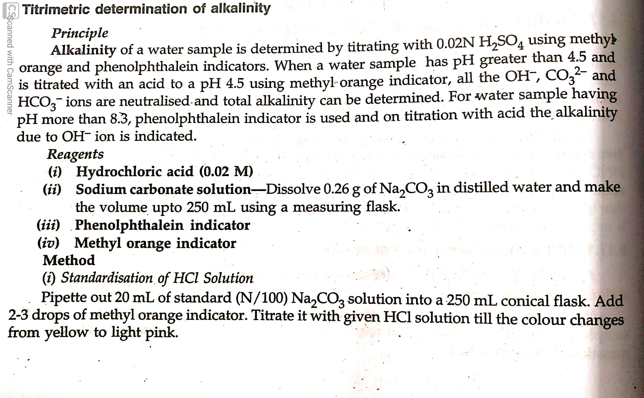
Principle and Method of determining Alkalinity of water

Slide 16
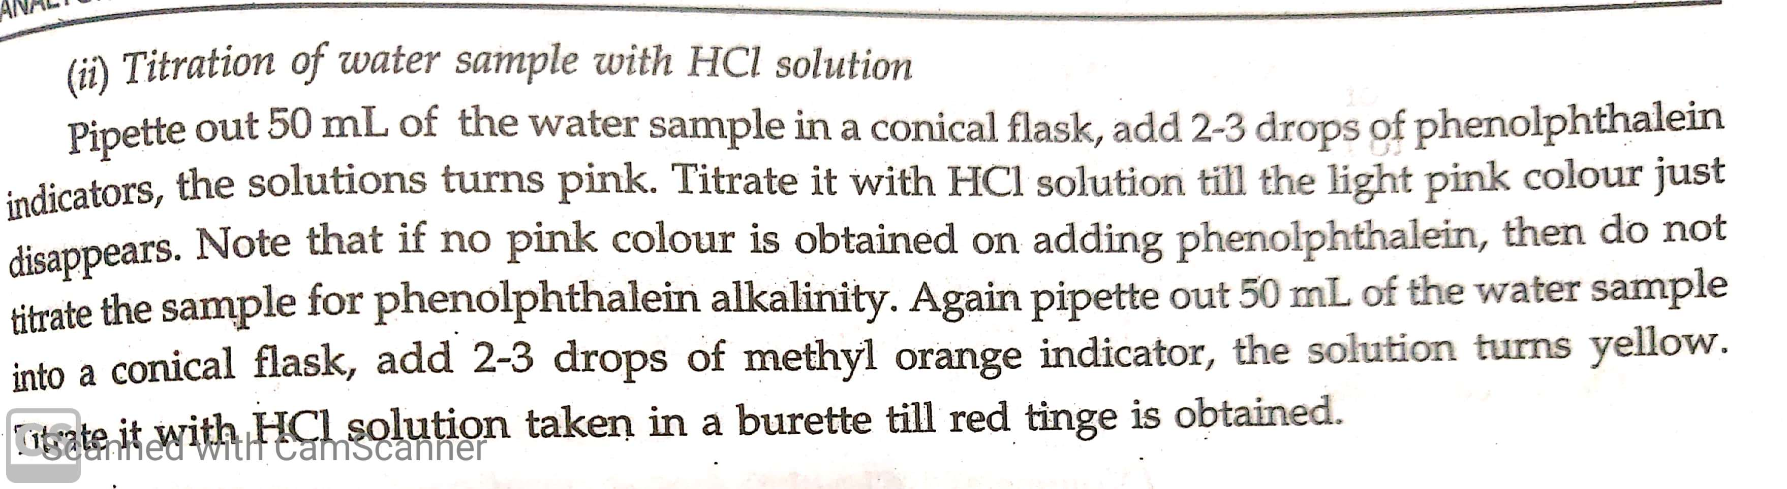
Method step 2

Slide 17
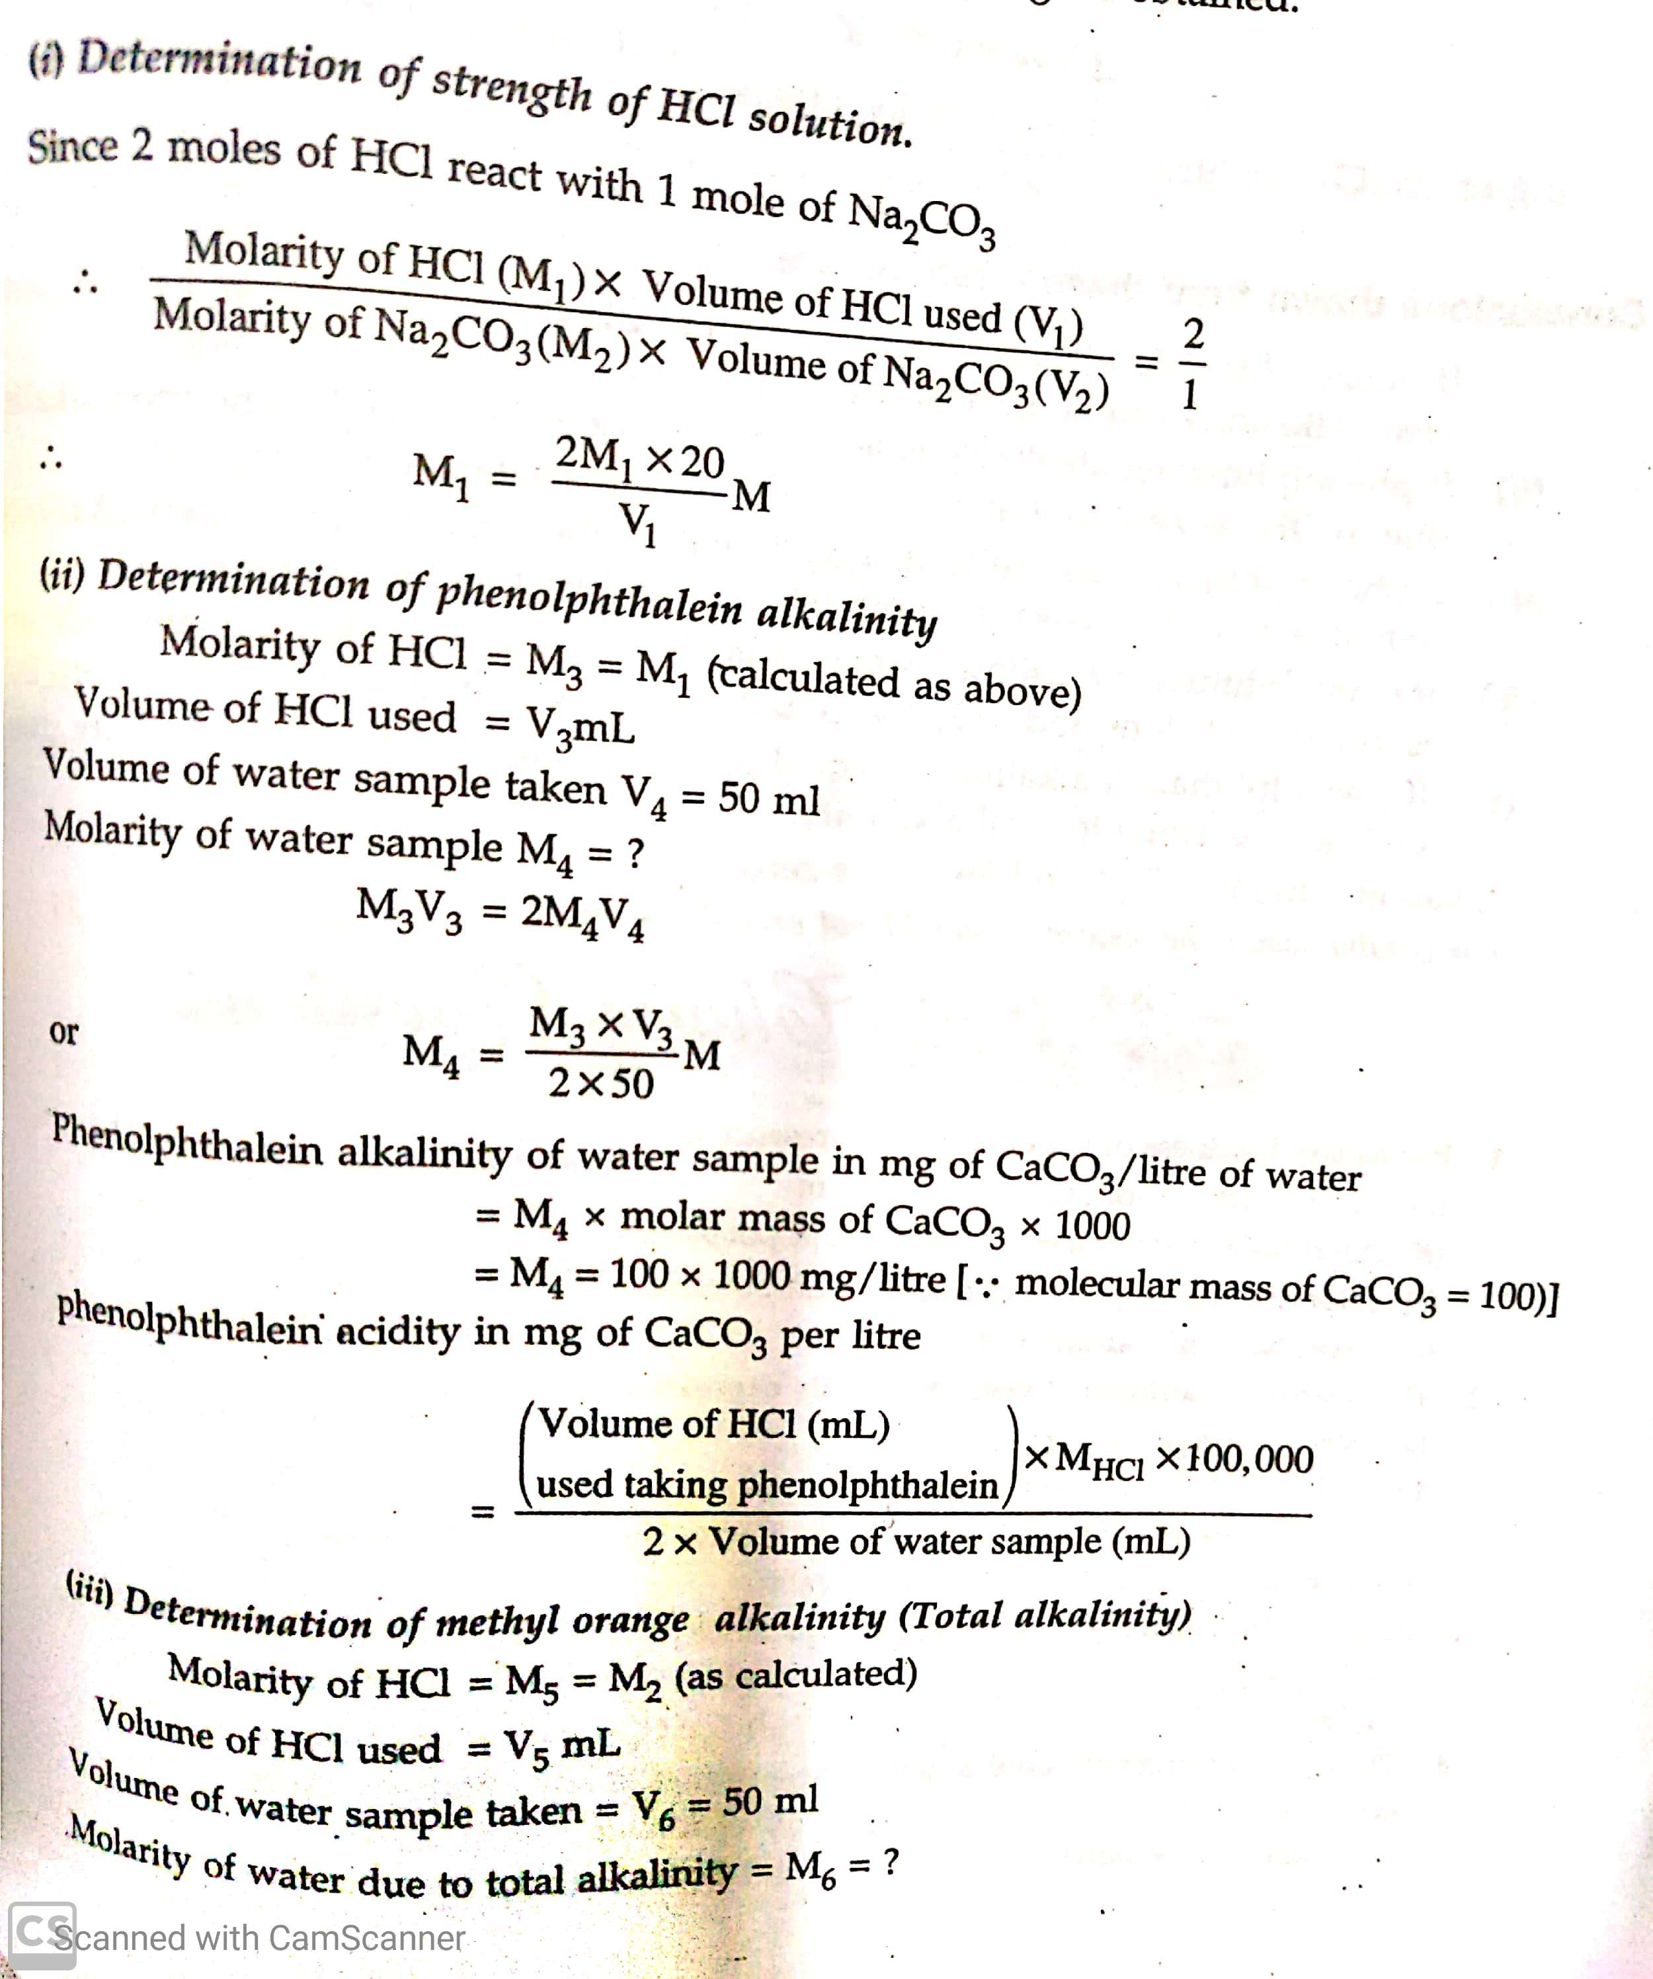
Calculation of alkalinity

Slide 18
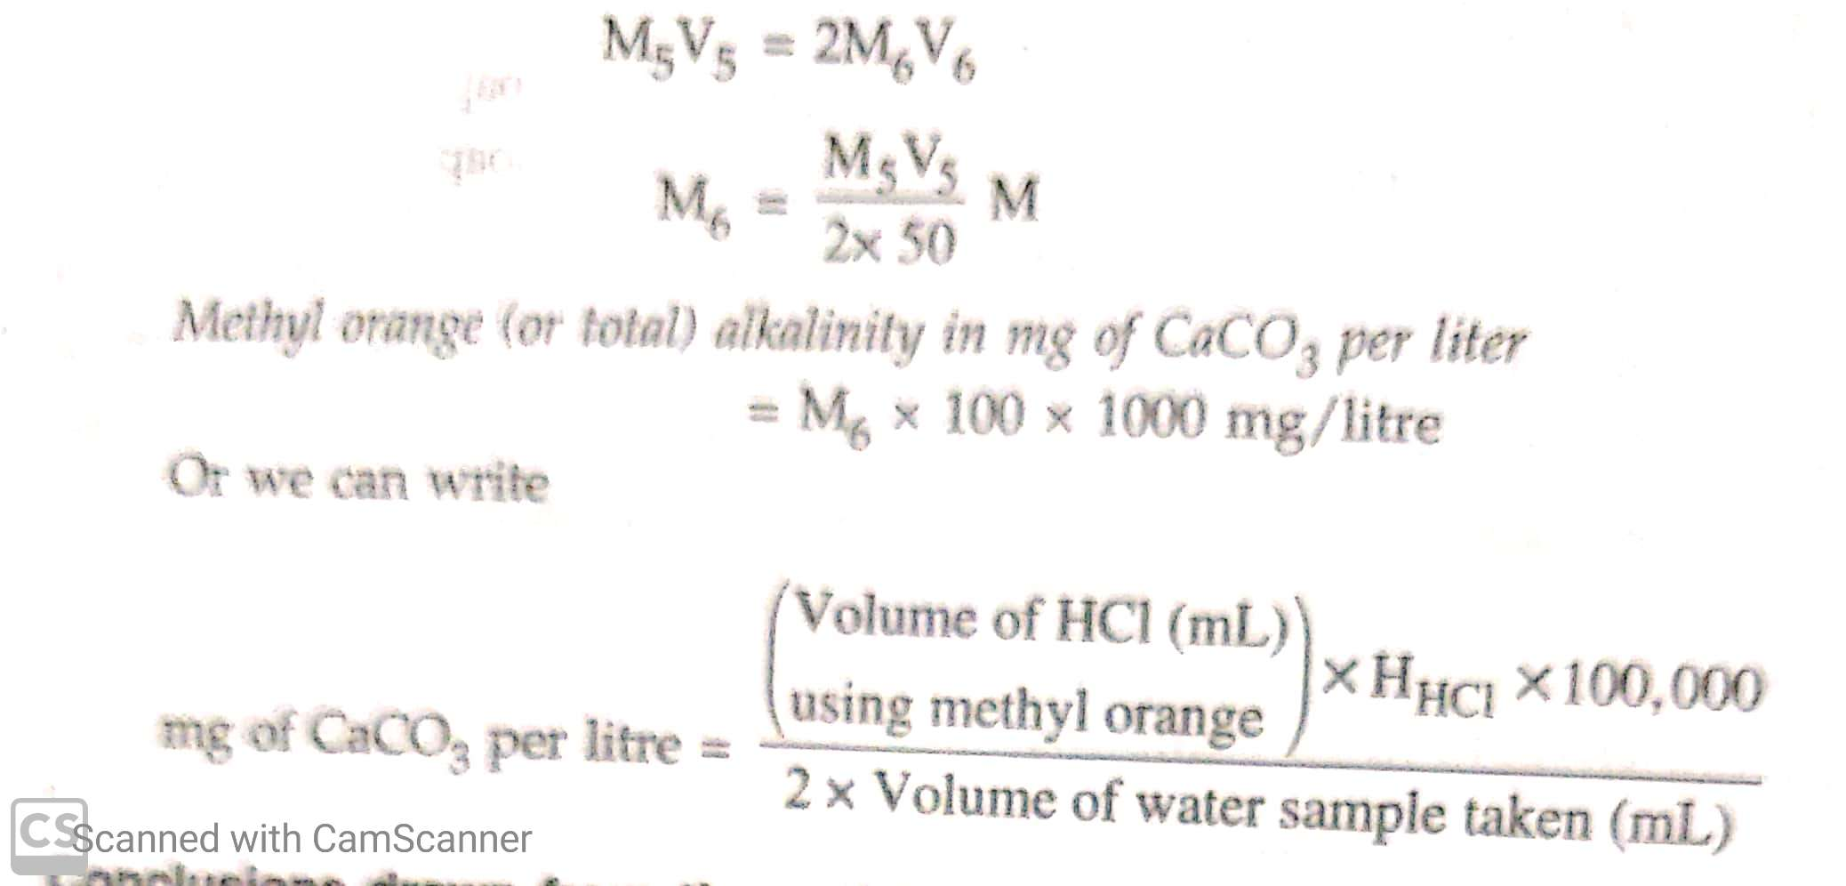
Calculation

Slide 19
Some important QUESTIONS
What is demineralisation of water?
What is ionic product of water ?
What is ph of pure water?
What is ph metric method of determining ph of water?
Explain the terms:
Chlorination , Fluoridation ,COD,BOD
What are parameters of drinking water?
What is the cause of acidity and alkalinity of water?

Slide 20

Thanx with a reminder that all the questions at the end of PPT are required to be written in a note book for submission.

